Slide 2
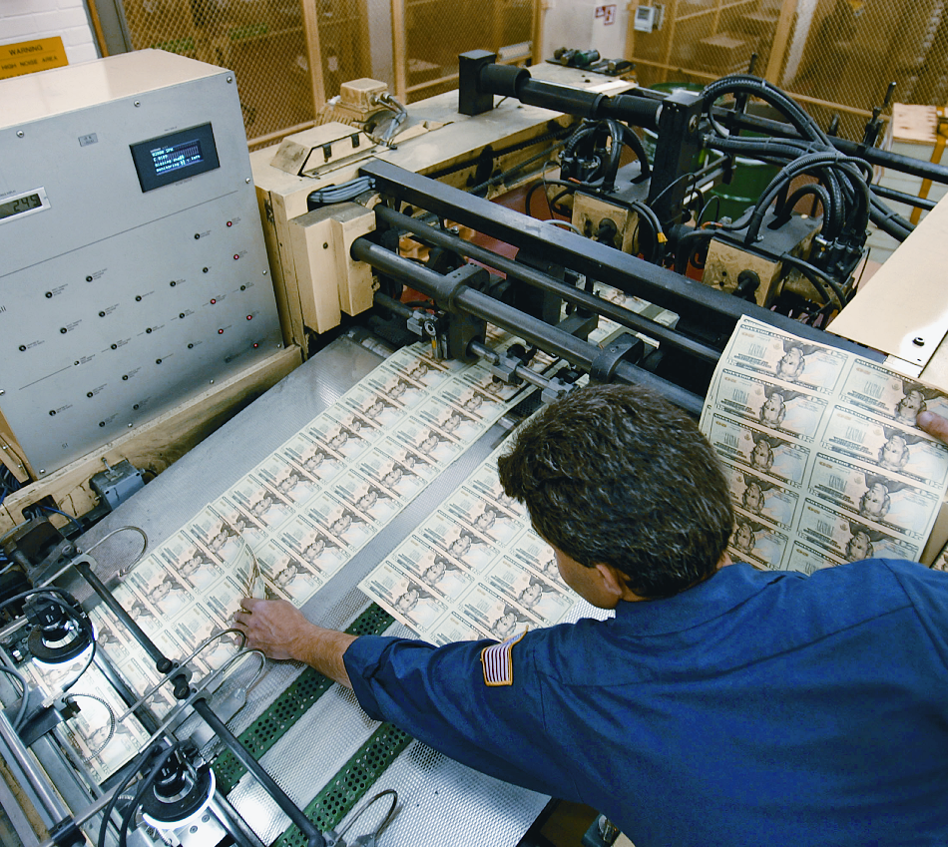
23
The Money Supply and
the Federal Reserve System
Chapter Outline
An Overview of Money
What Is Money?
Commodity and Fiat Monies
Measuring the Supply of Money in the United
States
The Private Banking System
How Banks Create Money
A Historical Perspective: Goldsmiths
The Modern Banking System
The Creation of Money
The Money Multiplier
The Federal Reserve System
Functions of the Federal Reserve
The Federal Reserve Balance Sheet
How the Federal Reserve Controls the
Money Supply
The Required Reserve Ratio
The Discount Rate
Open Market Operations
The Supply Curve for Money
Looking Ahead

Slide 3
AN OVERVIEW OF MONEY
WHAT IS MONEY?
Money is anything that is generally accepted as a medium of exchange.
A Means of Payment, or Medium of Exchange
barter The direct exchange of goods and services for other goods and services.
medium of exchange, or means of payment What sellers generally accept and buyers generally use to pay for goods and services.

Slide 4
AN OVERVIEW OF MONEY
A Store of Value
store of value An asset that can be used to transport purchasing power from one time period to another.
liquidity property of money The property of money that makes it a good medium of exchange as well as a store of value: It is portable and readily accepted and thus easily exchanged for goods.

Slide 5
AN OVERVIEW OF MONEY
A Unit of Account
unit of account A standard unit that provides a consistent way of quoting prices.

Slide 6
AN OVERVIEW OF MONEY
COMMODITY AND FIAT MONIES
commodity monies Items used as money that also have intrinsic value in some other use.
fiat, or token, money Items designated as money that are intrinsically worthless.

Slide 7
AN OVERVIEW OF MONEY
legal tender Money that a government has required to be accepted in settlement of debts.
currency debasement The decrease in the value of money that occurs when its
supply is increased rapidly.

Slide 8
AN OVERVIEW OF MONEY
MEASURING THE SUPPLY OF MONEY IN THE UNITED STATES
M1: Transactions Money
M1, or transactions money Money that can be directly used for transactions.
M1 ≡ currency held outside banks + demand deposits + traveler’s checks + other checkable deposits

Slide 9
AN OVERVIEW OF MONEY
M2: Broad Money
near monies Close substitutes for transactions money, such as savings accounts and money market accounts.
M2, or broad money M1 plus savings accounts, money market accounts, and other near monies.
M2 ≡ M1 + savings accounts + money market accounts + other near monies

Slide 10
AN OVERVIEW OF MONEY
Beyond M2
There are no rules for deciding what is money and what is not. This poses problems for economists and those in charge of economic policy.

Slide 11
AN OVERVIEW OF MONEY
THE PRIVATE BANKING SYSTEM
financial intermediaries Banks and other institutions that act as a link between those who have money to lend and those who want to borrow money.

Slide 12
HOW BANKS CREATE MONEY
A HISTORICAL PERSPECTIVE: GOLDSMITHS
run on a bank Occurs when many of those who have claims on a bank (deposits) present them at the same time.

Slide 13
HOW BANKS CREATE MONEY
THE MODERN BANKING SYSTEM
A Brief Review of Accounting
Assets − Liabilities ≡ Net Worth,
or
Assets ≡ Liabilities + Net Worth
Federal Reserve Bank (the Fed) The central bank of the United States.

Slide 14
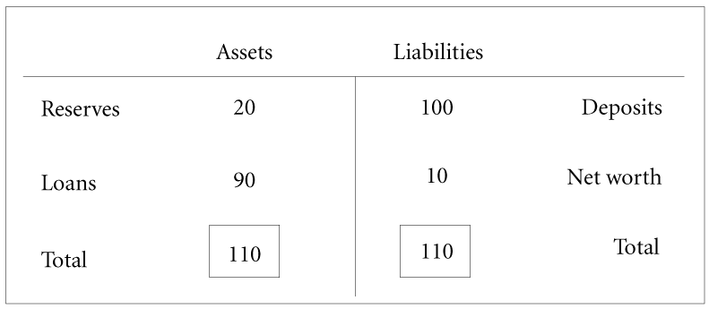
HOW BANKS CREATE MONEY
FIGURE 10.1 T-Account for a Typical Bank (millions of dollars)

Slide 15
HOW BANKS CREATE MONEY
reserves The deposits that a bank has at the Federal Reserve bank plus its cash on hand.
required reserve ratio The percentage of its total deposits that a bank must keep as reserves at the Federal Reserve.
When some item on a bank’s balance sheet changes, there must be at least one other
change somewhere else to maintain balance.

Slide 16
HOW BANKS CREATE MONEY
THE CREATION OF MONEY
Banks usually make loans up to the point where they can no longer do so because of the reserve requirement restriction.
excess reserves The difference between a bank’s actual reserves and its required reserves.
excess reserves ≡ actual reserves − required reserves

Slide 17
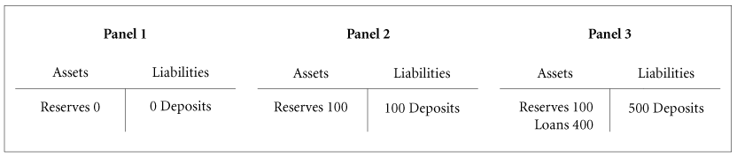
HOW BANKS CREATE MONEY
FIGURE 10.2 Balance Sheets of a Bank in a Single-Bank Economy

Slide 18
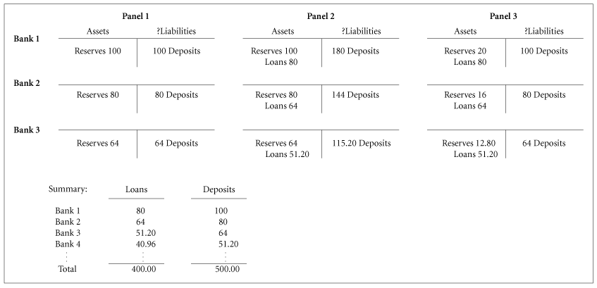
HOW BANKS CREATE MONEY
FIGURE 10.3 The Creation of Money When There Are Many Banks

Slide 19
HOW BANKS CREATE MONEY
THE MONEY MULTIPLIER
An increase in bank reserves leads to a greater than one-for-one increase in the money
supply. Economists call the relationship between the final change in deposits and the
change in reserves that caused this change the money multiplier. Stated somewhat differently, the money multiplier is the multiple by which deposits can increase for every
dollar increase in reserves.
money multiplier The multiple by which deposits can increase for every dollar increase in reserves; equal to 1 divided by the required reserve ratio.

Slide 20
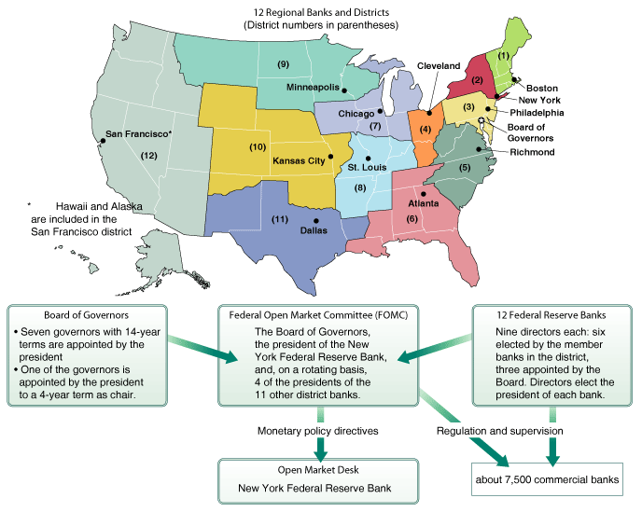
THE FEDERAL RESERVE SYSTEM
FIGURE 10.4 The Structure of the Federal Reserve System

Slide 21
THE FEDERAL RESERVE SYSTEM
Federal Open Market Committee (FOMC) A group composed of the seven members of the Fed’s Board of Governors, the president of the New York Federal Reserve Bank, and four of the other eleven district bank presidents on a rotating basis; it sets goals concerning the money supply and interest rates and directs the operation of the Open Market Desk in New York.
Open Market Desk The office in the New York Federal Reserve Bank from which government securities are bought and sold by the Fed.

Slide 22
THE FEDERAL RESERVE SYSTEM
FUNCTIONS OF THE FEDERAL RESERVE
Clearing Interbank Payments
The Fed does it.
The funds move at the speed of electricity from one computer account to another.

Slide 23
THE FEDERAL RESERVE SYSTEM
Other Duties of the Fed
lender of last resort One of the functions of the Fed: It provides funds to troubled banks that cannot find any other sources of funds.

Slide 24
THE FEDERAL RESERVE SYSTEM
THE FEDERAL RESERVE BALANCE SHEET
TABLE 10.1 Assets and Liabilities of the Federal Reserve System, August 3, 2005 (Millions of Dollars)
ASSETS |  |  |  |  |  | LIABILITIES
Gold |  | $ | 4,037 |  |  | $729,601 |  | Federal Reserve notes (outstanding)
Loans to banks |  |  | 3,330 |  |  |  |  | Deposits:
U.S. Treasury securities |  |  | 724,700 |  |  | 26,130 |  |  | Bank reserves (from depository institutions)
 |  |  |  |  |  | 4,813 |  |  | U.S. Treasury
All other assets |  |  | 81,843 |  |  | 60,366 |  | All other liabilities and net worth
Total |  | $ | 820,910 |  |  | $820,910 |  | Total
Source: Board of Governors of the Federal Reserve System.

Slide 25
HOW THE FEDERAL RESERVE CONTROLS
THE MONEY SUPPLY
If the Fed wants to increase the supply of money, it creates more reserves, thereby freeing
banks to create additional deposits by making more loans. If it wants to decrease the money supply, it reduces reserves.
Three tools are available to the Fed for changing the money supply:
(1) changing the required reserve ratio;
(2) changing the discount rate; and
(3) engaging in open market operations.

Slide 26
HOW THE FEDERAL RESERVE CONTROLS
THE MONEY SUPPLY
THE REQUIRED RESERVE RATIO
TABLE 10.2 A Decrease in the Required Reserve Ratio from 20 Percent to 12.5 Percent Increases the Supply of Money (All Figures in Billions of Dollars)
PANEL 1: REQUIRED RESERVE RATIO = 20%
Federal Reserve |  |  |  |  |  |  | Commercial Banks
Assets |  |  | Liabilities |  |  |  | Assets |  | Liabilities
Government |  | $200 | $100 |  | Reserves |  | Reserves | $100 | $500 | Deposits
 | securities |  | $100 |  | Currency |  | Loans | $400
Note: Money supply (M1) = Currency + Deposits = $600.
PANEL 2: REQUIRED RESERVE RATIO = 12.5%
Federal Reserve |  |  |  |  |  |  | Commercial Banks
Assets |  |  |  | Liabilities |  |  | Assets |  | Liabilities
Government |  | $200 | $100 |  | Reserves |  | Reserves | $100 | $800 | Deposits
 | securities |  | $100 |  | Currency |  | Loans (+ $300) | $700 |  | (+ $300)
Note: Money supply (M1) = Currency + Deposits = $900.

Slide 27
HOW THE FEDERAL RESERVE CONTROLS
THE MONEY SUPPLY
Decreases in the required reserve ratio allow banks to have more deposits with the existing volume of reserves. As banks create more deposits by making loans, the supply of money (currency + deposits) increases. The reverse is also true: If the Fed wants to restrict the supply of money, it can raise the required reserve ratio, in which case banks will find that they have insufficient reserves and must therefore reduce their deposits by “calling in” some of their loans. The result is a decrease in the money supply.

Slide 28
HOW THE FEDERAL RESERVE CONTROLS
THE MONEY SUPPLY
THE DISCOUNT RATE
discount rate Interest rate that banks pay to the Fed to borrow from it.
Bank borrowing from the Fed leads to an increase in the money supply.

Slide 29
HOW THE FEDERAL RESERVE CONTROLS
THE MONEY SUPPLY
TABLE 10.3 The Effect on the Money Supply of Commercial Bank Borrowing from the Fed (All Figures in Billions of Dollars)
PANEL 1: NO COMMERCIAL BANK BORROWING FROM THE FED
Federal Reserve |  |  |  |  |  | Commercial Banks
Assets |  |  | Liabilities |  |  | Assets |  | Liabilities
Securities |  | $160 | $80 | Reserves | Reserves |  | $80 | $400 | Deposits
 |  |  | $80 | Currency | Loans |  | $320
Note: Money supply (M1) = Currency + Deposits = $480.
PANEL 2: COMMERCIAL BANK BORROWING $20 FROM THE FED
Federal Reserve |  |  |  |  |  | Commercial Banks
Assets |  |  | Liabilities |  |  | Assets |  | Liabilities
Securities |  | $160 | $100 | Reserves (+ $20) | Reserves (+ $20) |  | $100 | $500 | Deposits (+ $300)
Loans |  | $20 | $80 | Currency | Loans (+ $100) |  | $420 | $20 | Amount owed to Fed (+ $20)
Note: Money supply (M1) = Currency + Deposits = $580.

Slide 30
HOW THE FEDERAL RESERVE CONTROLS
THE MONEY SUPPLY
The Fed can influence bank borrowing, and thus the money supply, through the discount
rate:
The higher the discount rate, the higher the cost of borrowing, and the less borrowing
banks will want to do.
moral suasion The pressure that in the past the Fed exerted on member banks to discourage them from borrowing heavily from the Fed.

Slide 31
HOW THE FEDERAL RESERVE CONTROLS
THE MONEY SUPPLY
OPEN MARKET OPERATIONS
open market operations The purchase and sale by the Fed of government securities in the open market; a tool used to expand or contract the amount of reserves in the system and thus the money supply.

Slide 32
HOW THE FEDERAL RESERVE CONTROLS
THE MONEY SUPPLY
Two Branches of Government Deal in Government Securities
The Treasury Department is responsible for collecting taxes and paying the federal government’s bills.
The Treasury cannot print money to finance the deficit.
The Fed is not the Treasury. Instead, it is a quasi-independent agency authorized by
Congress to buy and sell outstanding (preexisting) U.S. government securities on the open market.

Slide 33
HOW THE FEDERAL RESERVE CONTROLS
THE MONEY SUPPLY
The Mechanics of Open Market Operations
TABLE 10.4 Open Market Operations (The Numbers in Parentheses in Panels 2 and 3 Show the Differences Between Those Panels and Panel 1. All Figures in Billions of Dollars)
PANEL 1
Federal Reserve |  |  |  |  | Commercial Banks |  |  |  | Jane Q. Public
Assets |  |  | Liabilities |  | Assets |  | Liabilities |  | Assets |  |  |  | Liabilities
Securities |  | $100 | $20 | Reserves | Reserves | $20 | $100 | Deposits | Deposits |  |  | $5 | $0 | Debts
 |  |  | $80 | Currency | Loans | $80 |  |  |  |  |  |  | $5 | Net Worth
Note: Money supply (M1) = Currency + Deposits = $180. |  |  |  |  |  |  |  |  |  |  |  |  | $80 | Currency
PANEL 2
Federal Reserve |  |  |  |  | Commercial Banks |  |  |  | Jane Q. Public
Assets |  |  | Liabilities |  | Assets |  | Liabilities |  | Assets |  |  |  | Liabilities
Securities (− $5) |  | $95 | $15 | Reserves (− $5) | Reserves (− $5) | $15 | $95 | Deposits (− $5) | Deposits (− $5) |  | $0 |  | $0 | Debts
 |  |  | $80 | Currency | Loans | $80 |  |  | Securities (+ $5) |  | $5 |  | $5 | Net Worth
Note: Money supply (M1) = Currency + Deposits = $175.
PANEL 3
Federal Reserve |  |  |  |  | Commercial Banks |  |  |  |  | Jane Q. Public
Assets |  |  | Liabilities |  | Assets |  | Liabilities |  | Assets |  |  |  | Liabilities
Securities (− $5) |  | $95 | $15 | Reserves (− $5) | Reserves (− $5) | $15 | $75 | Deposits (− $25) | Deposits (− $5) |  |  | $0 | $0 | Debts
 |  |  | $80 | Currency | Loans (− $20) | $60 |  |  | Securities (+ $5) |  |  | $5 | $5 | Net Worth
Note: Money supply (M1) = Currency + Deposits = $155.

Slide 34
HOW THE FEDERAL RESERVE CONTROLS
THE MONEY SUPPLY
We can sum up the effect of these open
market operations this way:
■ An open market purchase of securities by the Fed results in an increase in reserves and an increase in the supply of money by an amount equal to the money multiplier times the change in reserves.
■ An open market sale of securities by the Fed results in a decrease in reserves and a decrease in the supply of money by an amount equal to the money multiplier times the change in reserves.

Slide 35
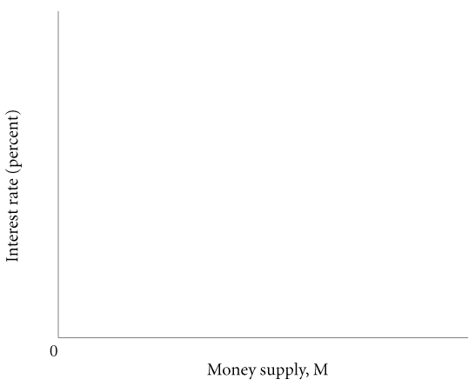
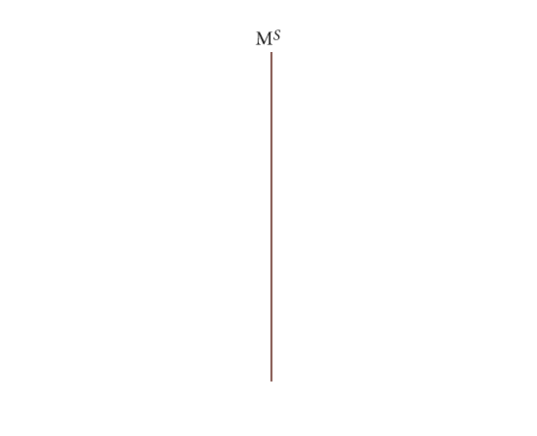
HOW THE FEDERAL RESERVE CONTROLS
THE MONEY SUPPLY
THE SUPPLY CURVE FOR MONEY
FIGURE 10.5 The Supply of Money

Slide 36
REVIEW TERMS AND CONCEPTS
barter
commodity monies
currency debasement
discount rate
excess reserves
Federal Open Market Committee (FOMC)
Federal Reserve Bank (the Fed)
fiat, or token, money
financial intermediaries
legal tender
lender of last resort
liquidity property of money
M1, or transactions money
M2, or broad money
medium of exchange, or means of payment
money multiplier
moral suasion
near monies
Open Market Desk
open market operations
required reserve ratio
reserves
run on a bank
store of value
unit of account
1. M1 ≡ currency held outside banks + demand deposits + traveler’s checks + other checkable deposits
2. M2 ≡ M1 + savings accounts + money market accounts + other near monies
3. Assets ≡ liabilities + capital (or net worth)
4. Excess reserves ≡ actual reserves − required reserves
5. Money multiplier ≡

